Slide 1
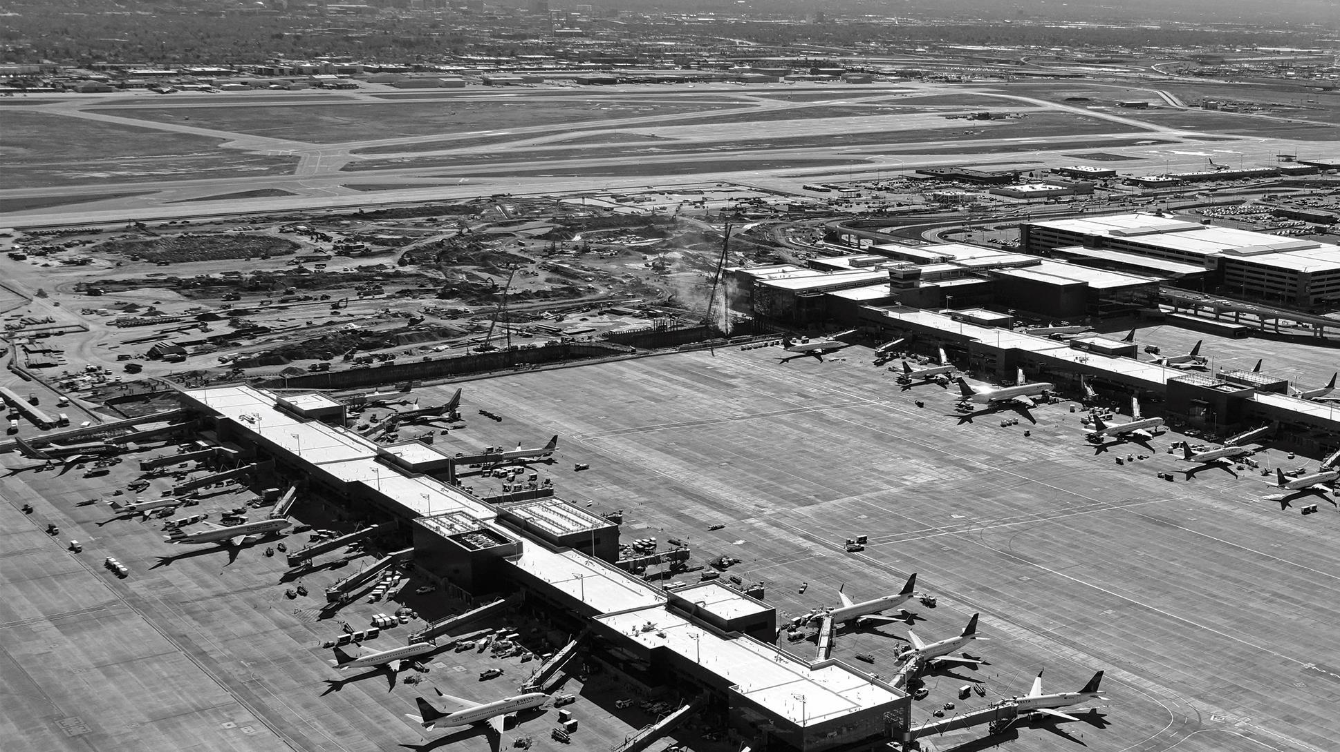

v
Salt Lake City International
Airport Master Plan

Slide 2

What is a Master Plan?
“An airport master plan is a comprehensive study of an airport and usually describes the short-, medium-, and long term development plans to meet future aviation demand.“
-FAA Advisory Circular 150/5070-6B Airport Master Plans

Slide 3
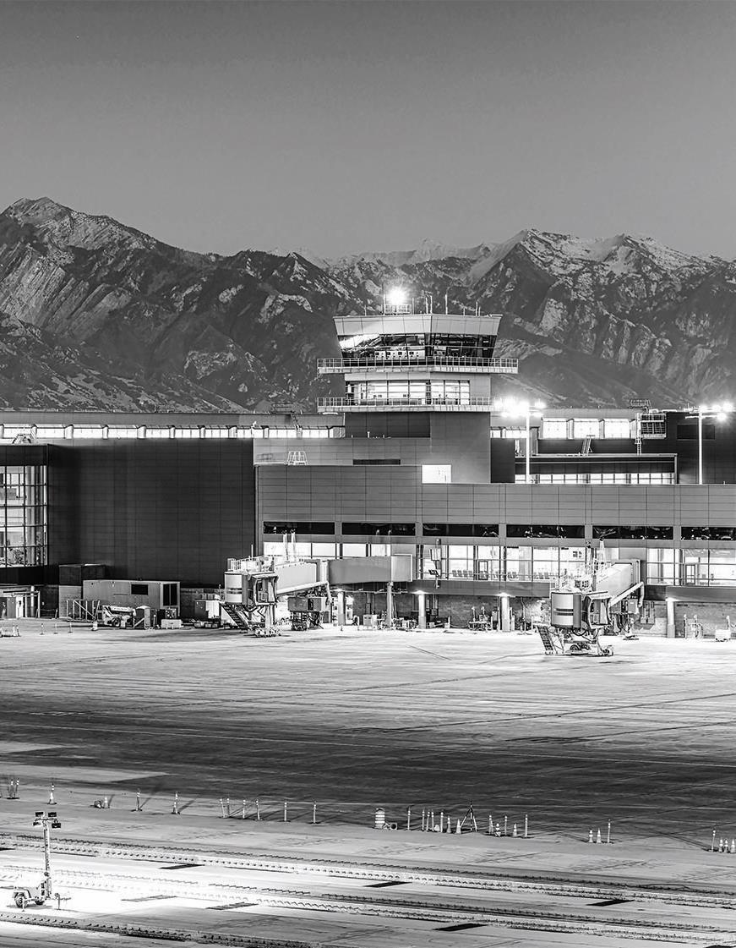
Whose project is this?
The Master Plan was prepared by the Salt Lake City
Department of Airports and their consultants.
The preparation of this document was financed in part through a planning grant from the Federal Aviation Administration (FAA) as provided under Section 505 of the Airport and Airways Improvement Act of 1982, as amended by the Airway Safety and Capacity Expansion Act of 1987.

Slide 4
What was the planning process?
Public Involvement/Stakeholder Coordination
Stakeholder Scoping Sessions Advisory Committee Airline Working Group Public Workshops Website
Inventory
Aviation Activity
Forecasts
Facility
Requirements
Alternatives
Development
Development
Plan
Collect Physical and Operational Characteristics
- Airfield
- Terminal
- Landslide
- Support Facilities
Review Historical Activity
Identify Trends and Relationships
Forecast Future Activity
Assess Existing Facility Capacities
Determine
Future Facility Requirements
Identify Alternatives
Short-List Alternatives
Refine Alternatives
Evaluate Alternatives
Select Preferred Alternative
Identify Preferred Development Plan
Determine Plan Phasing
Estimate Project Costs

Slide 5
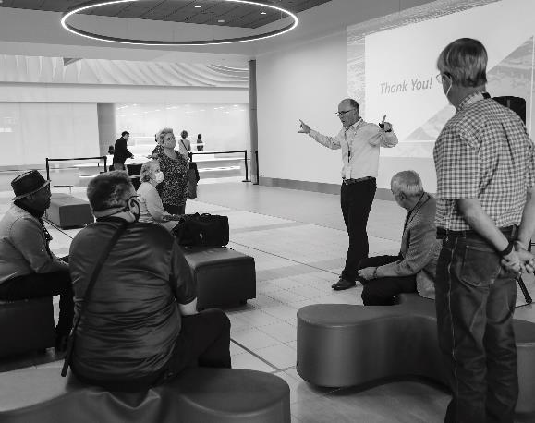

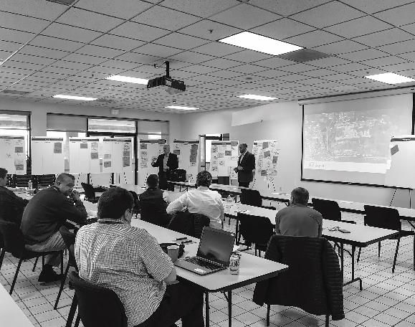
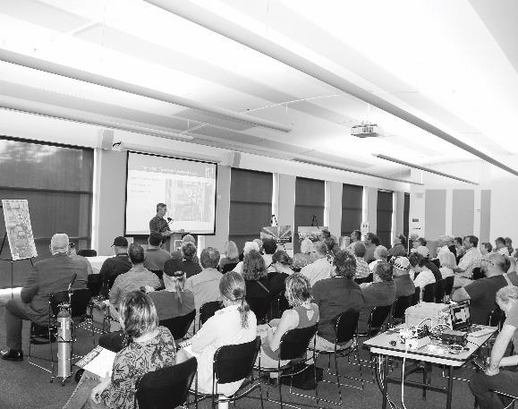
How was your community involved?
The SLCIA Master Plan analysis was guided by several committees and a thorough public involvement program was deployed to seek public feedback during all phases of the project and at all key decision points.

Slide 6

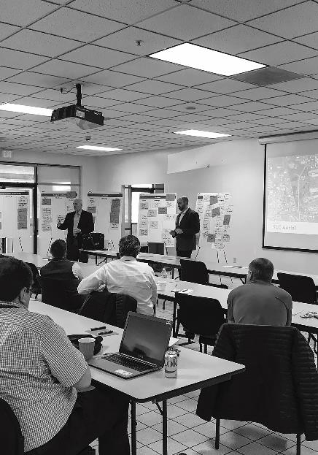
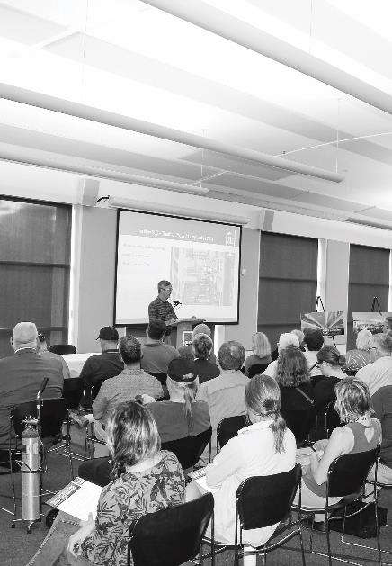

How was your community involved?
There was 1 Virtual Engagement Room, 3 Public Information Meetings, 7 Airport Board updates, 6 working papers posted, 40 technical meetings, 65 stakeholder meetings, 350 public participants, and over 20,000 hours of planning conducted during the process.
www.slcairport.com/about-the-airport/master-plan/

Slide 7

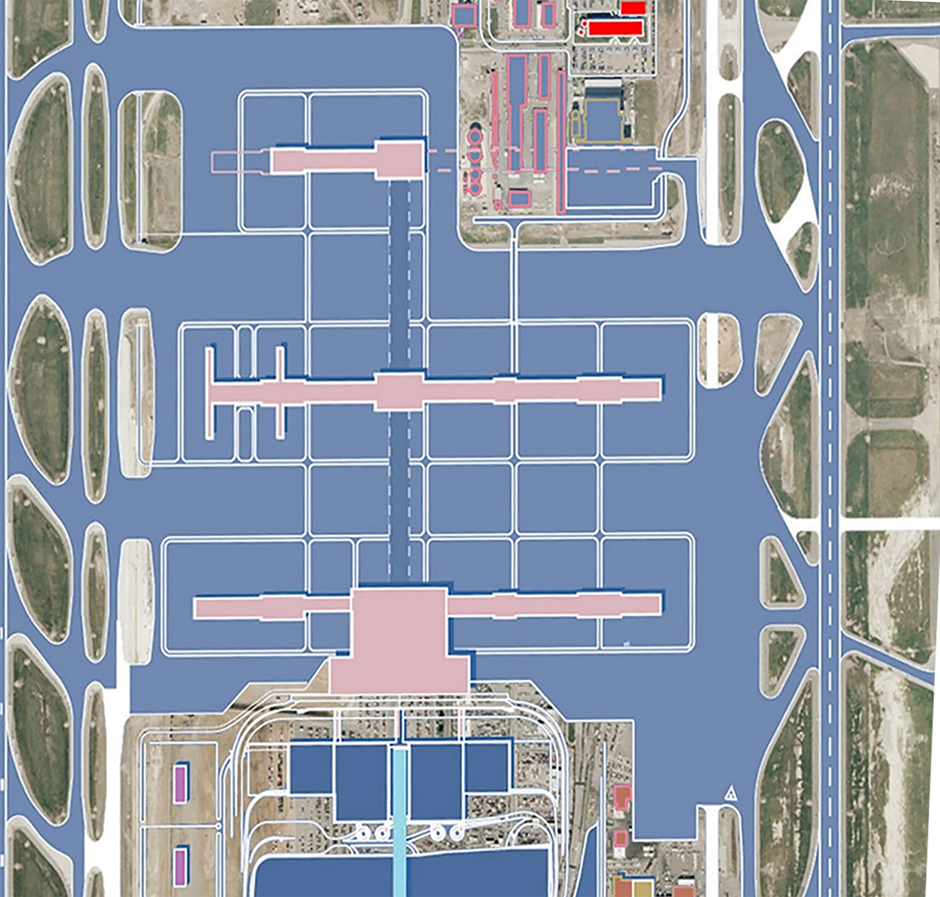
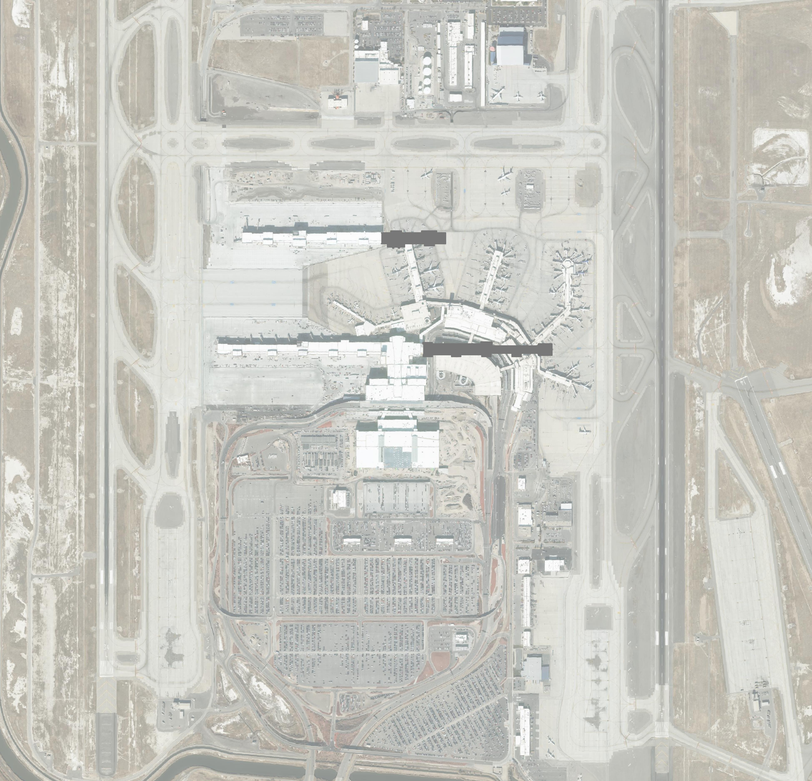
Introduction
1998 Master Plan Vision
Today Being Realized!

Slide 8
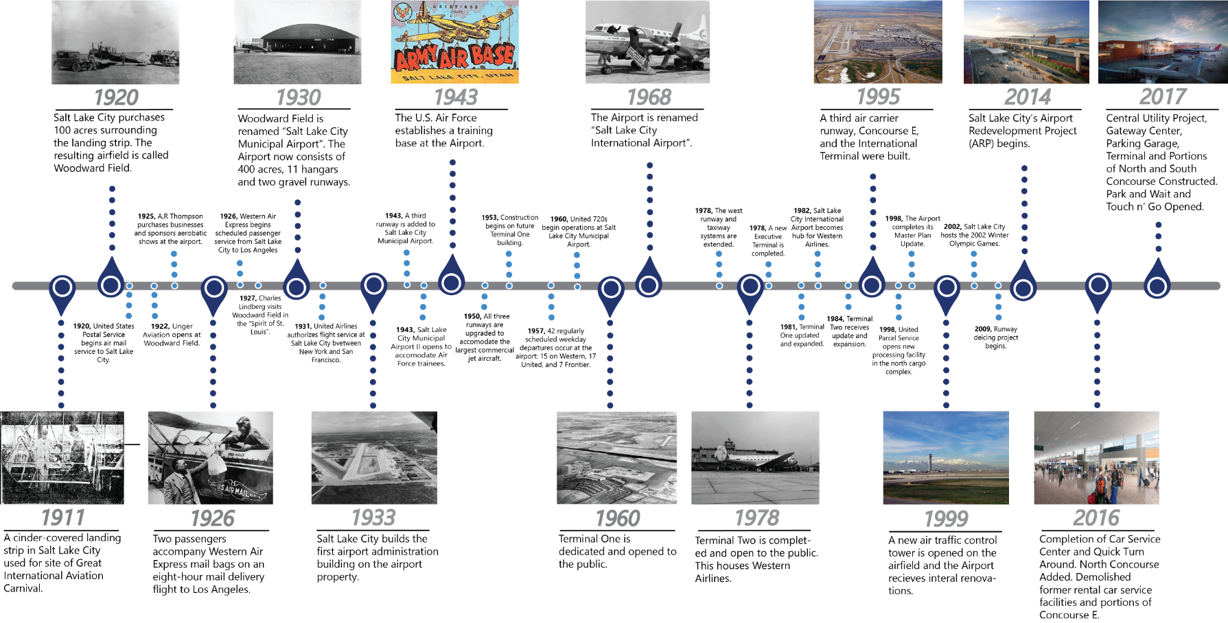
Inventory and History

Slide 9
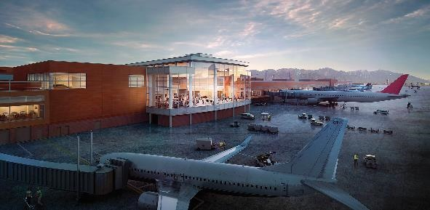
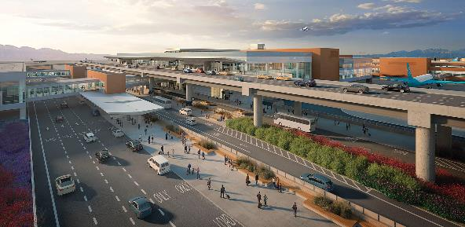

Inventory and History
2018-19
2020
2021-24
Central Utility Project, Gateway
Center, Parking Garage, Terminal
and portions of New Concourses
A and B construction continues.
Break ground on New
Concourse B-west.
Completion of Gateway Center, Parking Garage, Terminal, New Concourse A-west.
Demolish existing parking garages and former Terminals 1 and 2 / former Concourses A and E.
New Concourse B-west opens
New Concourses A and B-east construction
Former Concourses B an C demolished
Project completion

Slide 10

Aviation Activity
Forecast
The forecast of aviation demand provides a basis for determining future facility requirements including the type, size, and timing of aviation development. Consequently, the forecast influences virtually all phases of the planning process.

Slide 11

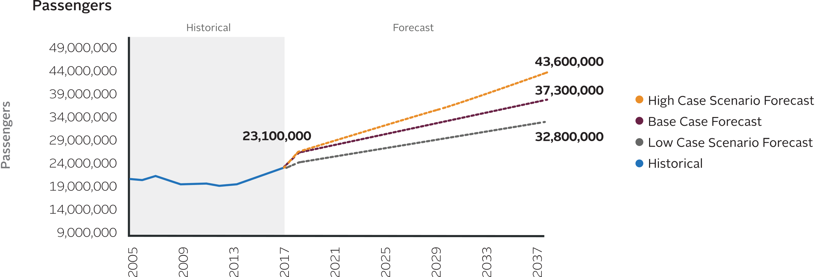
Aviation Activity Forecast

Slide 12
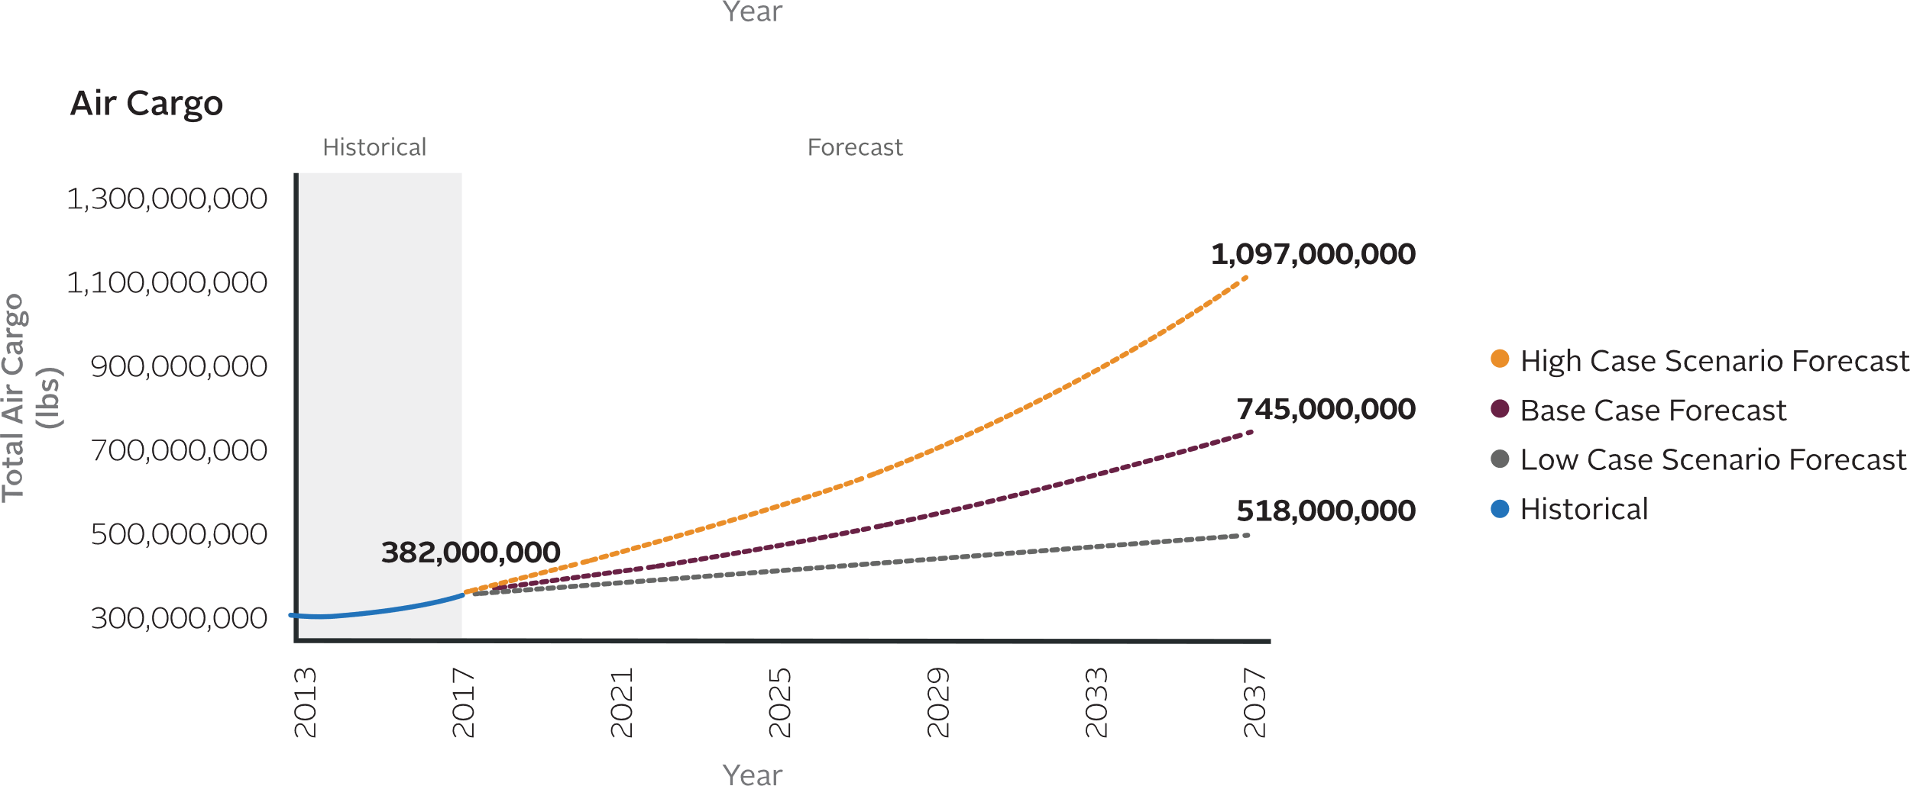
Aviation Activity Forecast

Slide 13
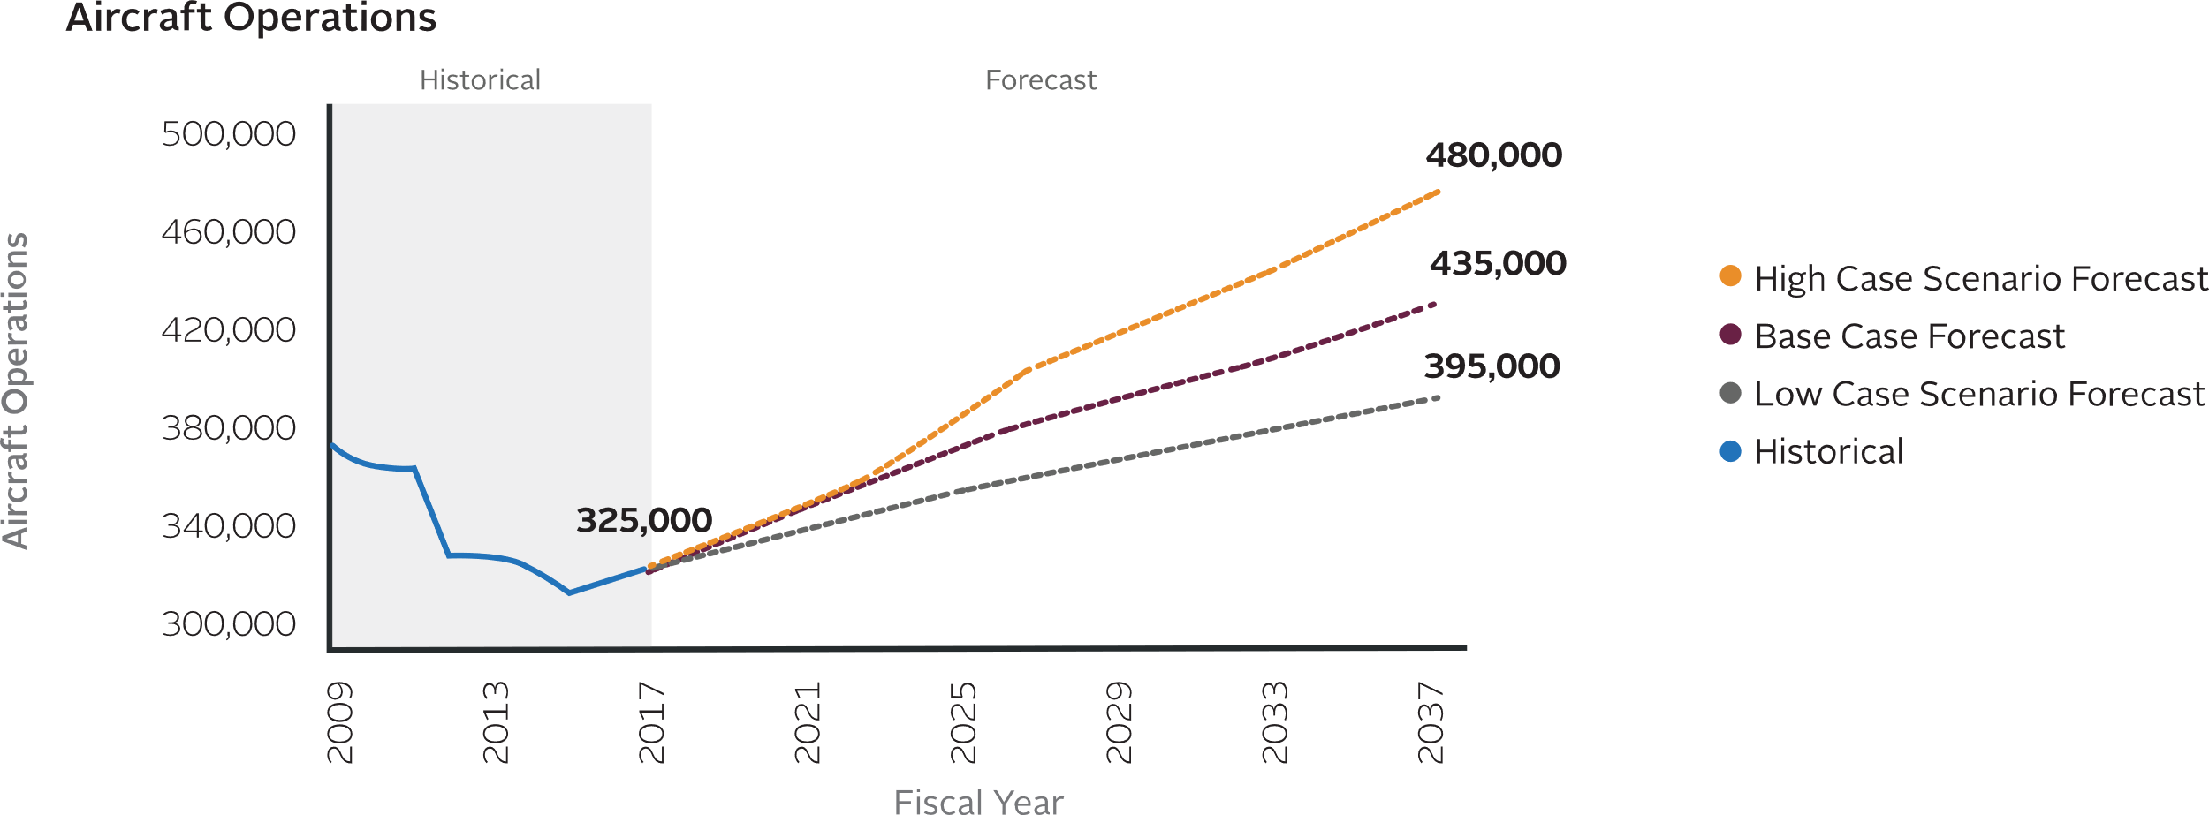
Aviation Activity Forecast

Slide 14
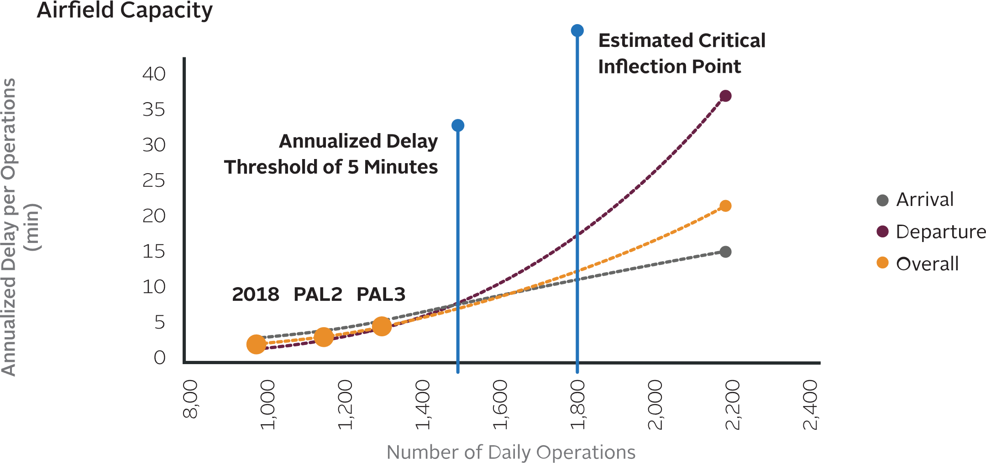
Aviation Activity Forecast

Slide 15

Facility Requirements
Future airport facility requirements, including the type, size, and quantity, are dependent on future aviation activity levels projected in the aviation
demand forecasts.

Slide 16


Facility Requirements

Slide 17
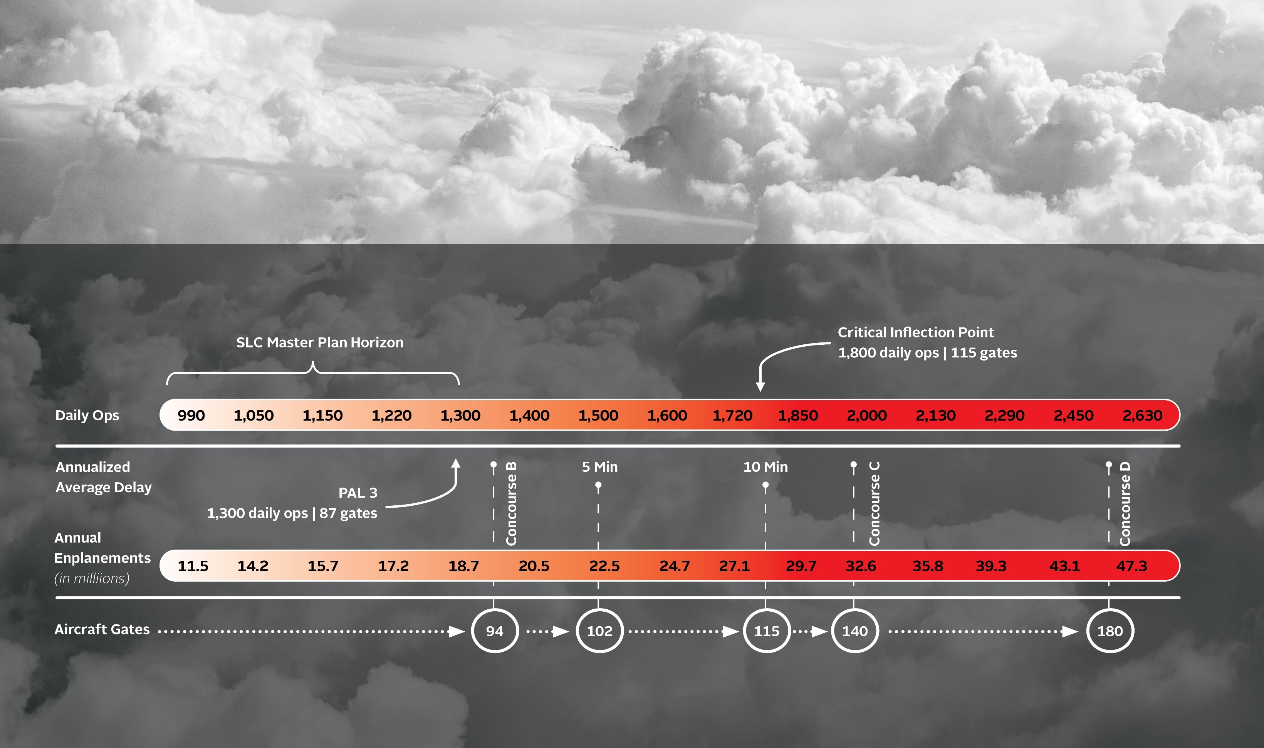
Balanced Airport

Slide 18
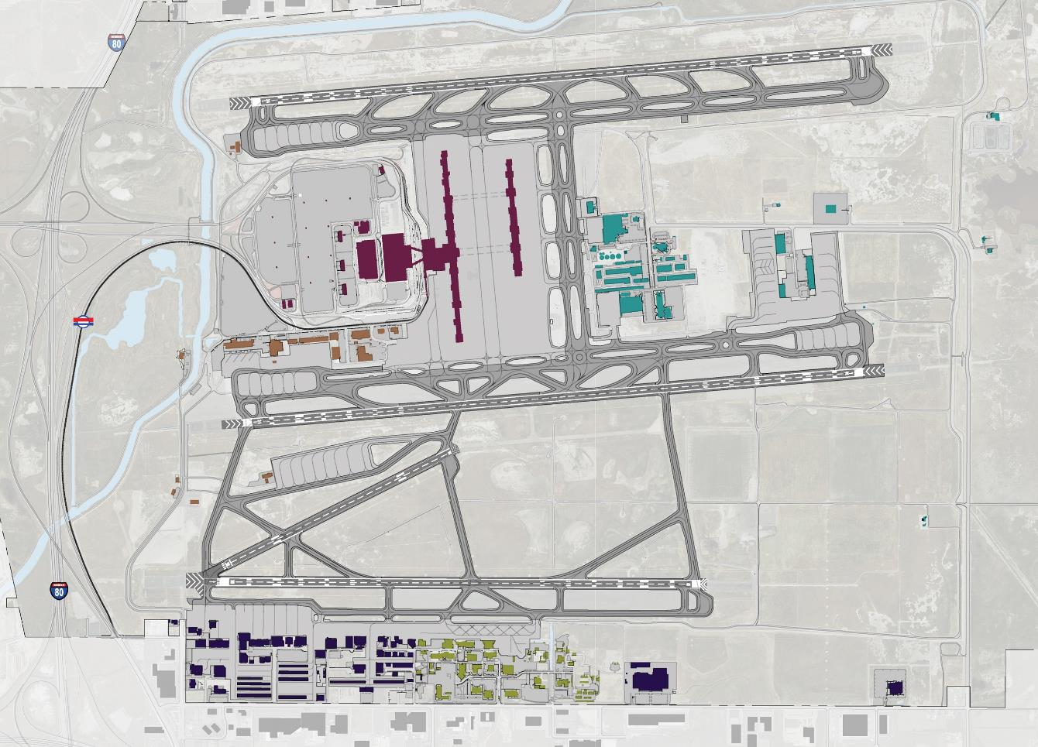
Existing
Conditions

Slide 19

Solutions
The solutions identified ensure airport facilities are capable of meeting projected activity demand levels, are making efficient and effective use of available airport land and are meeting FAA airfield design standards.

Slide 20
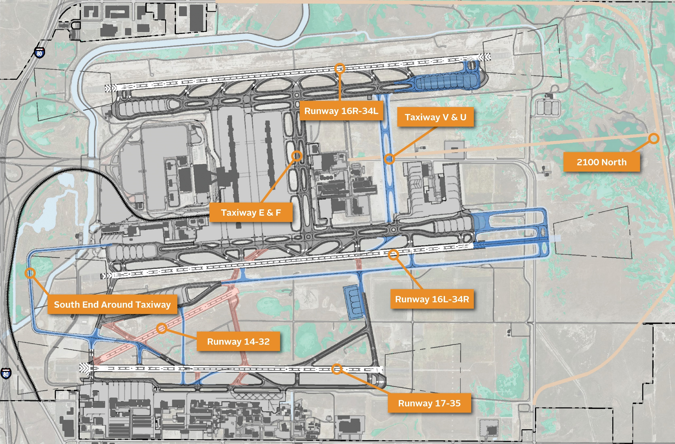
Airfield

Slide 21
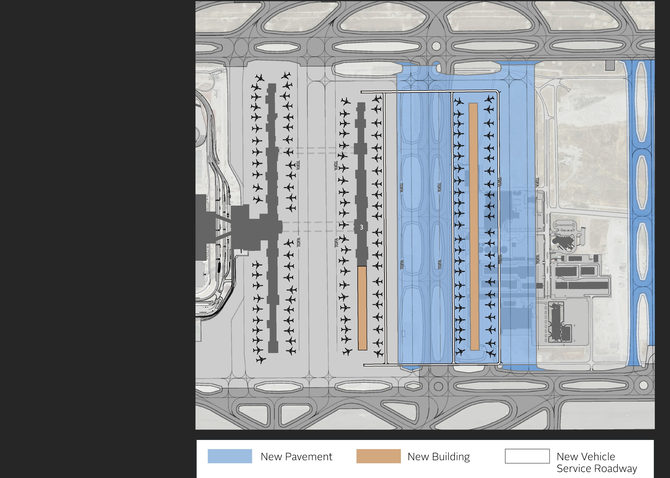
Terminal and Gates

Slide 22
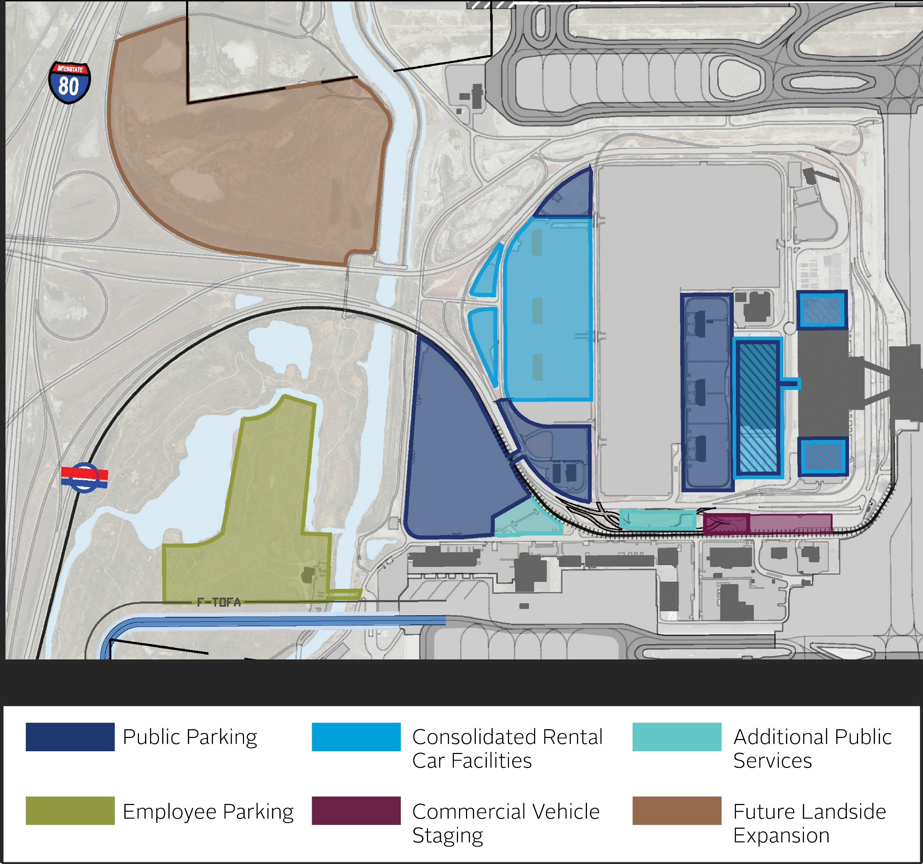
Landside

Slide 23
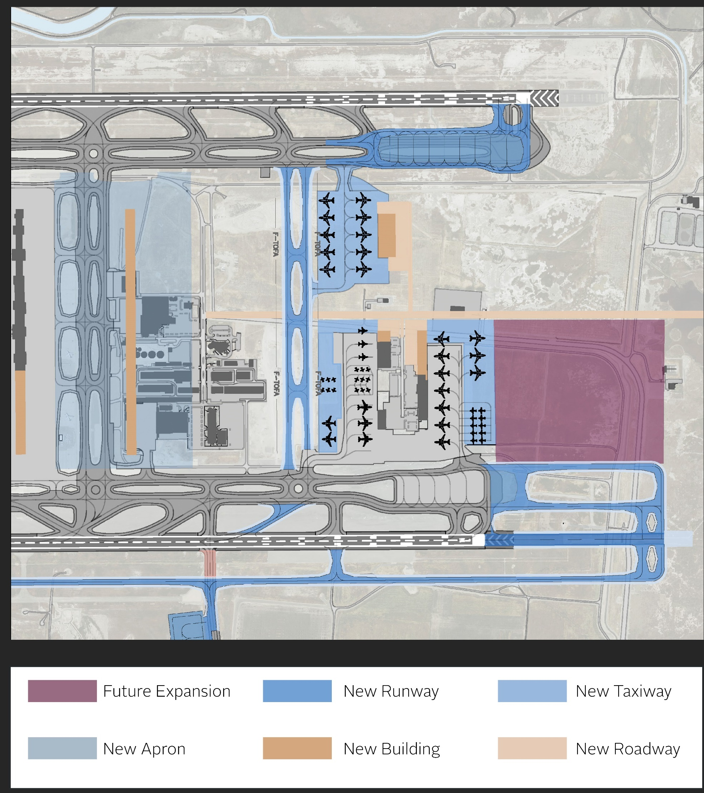
Cargo and Support

Slide 24
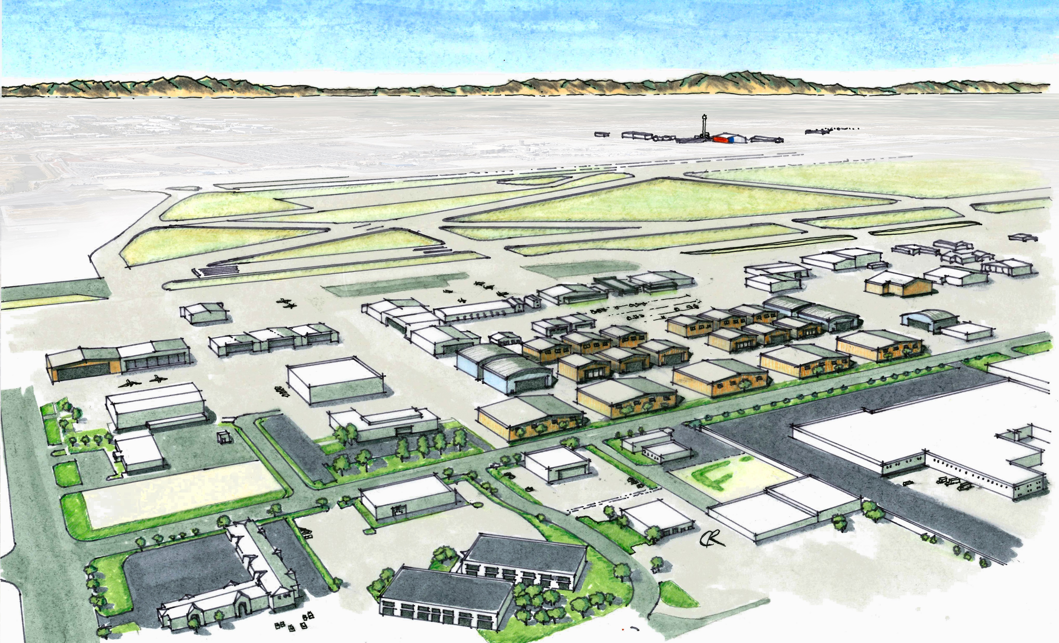
General Aviation

Slide 25

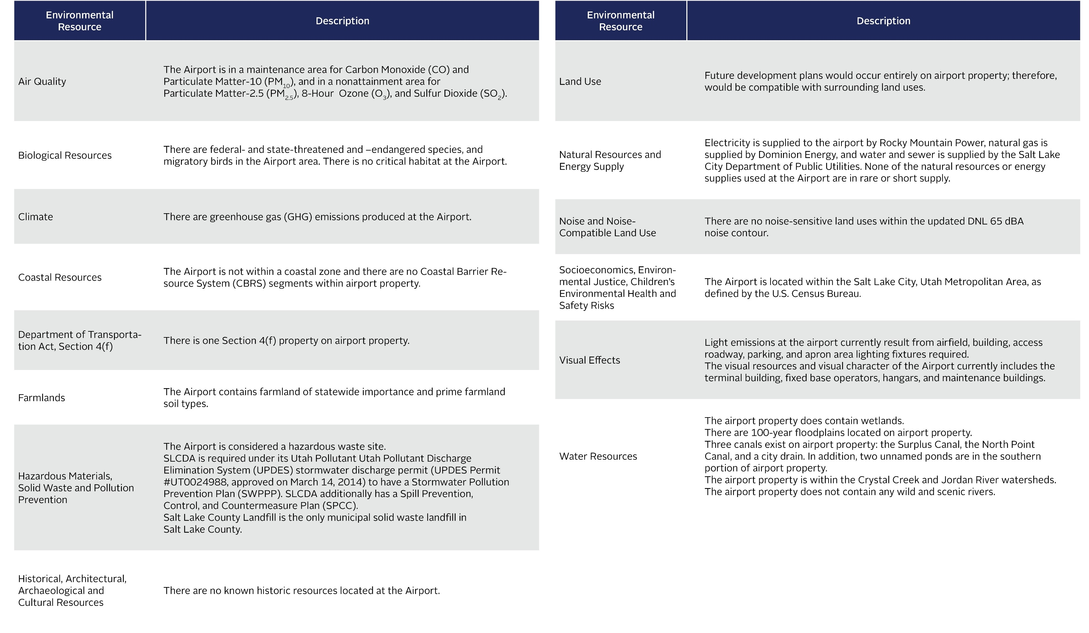
Environmental Overview

Slide 26
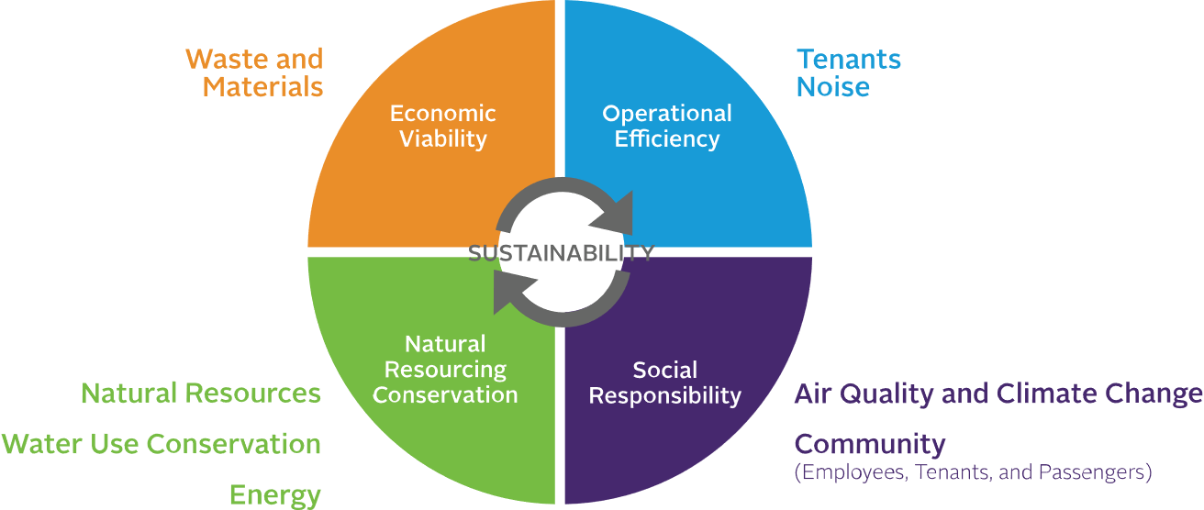

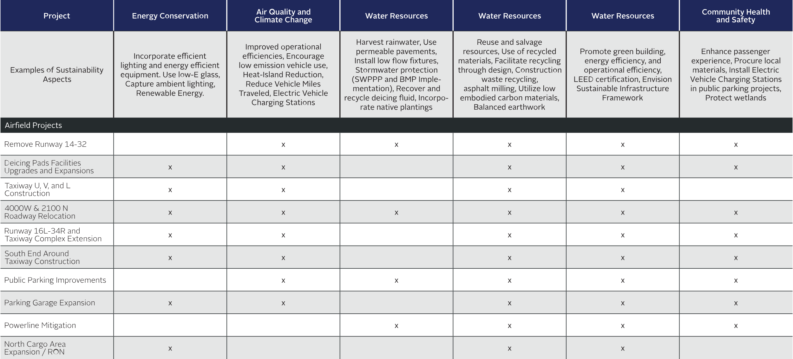
Sustainability

Slide 27
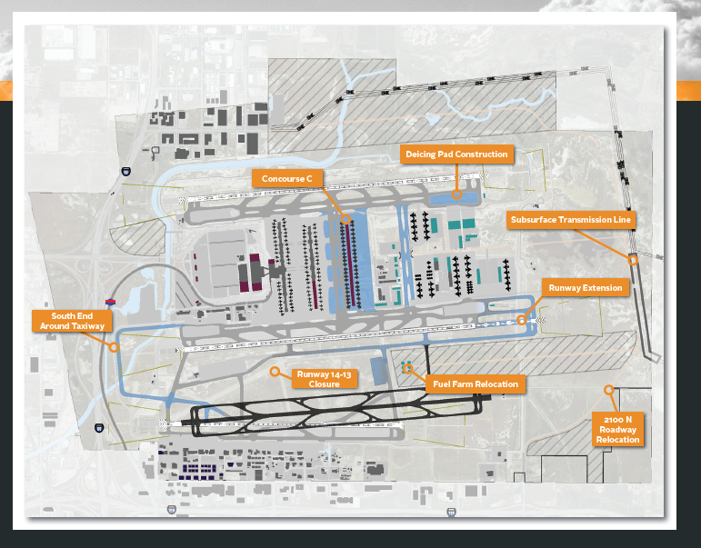
Strategic Vision
The 1998 Master Plan study set forth the path for new terminal and concourse facilities. This 2021 Master Plan’s strategic vision strikes a strategic
balance of airfield and support facilities improvements to match passenger demand anticipated within and beyond the planning period.
SLCDA will balance passenger demand with airfield projects that improve operational efficiency, enhance safety, and increase overall airfield capacity.

Slide 28

Future Development
The preferred solution for each facility was combined into a comprehensive preferred alternative. The plan for future development identifies short-term (0 to 5 years), mid-term (6 to 10 years), and long-term (11 to 20-years) projects. The division between short-, mid-, and long-range projects was established through an evaluation process based on priority, need, and the SLCDA Vision. The following priorities were established to guide the sequencing of the projects in the Development Plan:
Priority 1 – Address all safety and design deficiencies
Priority 2 – Maximize the capacity and efficiency of SLCIA
Priority 3 – Utilize demand reduction techniques to delay major
capacity enhancements
Priority 4 – Provide additional runway capacity

Slide 29

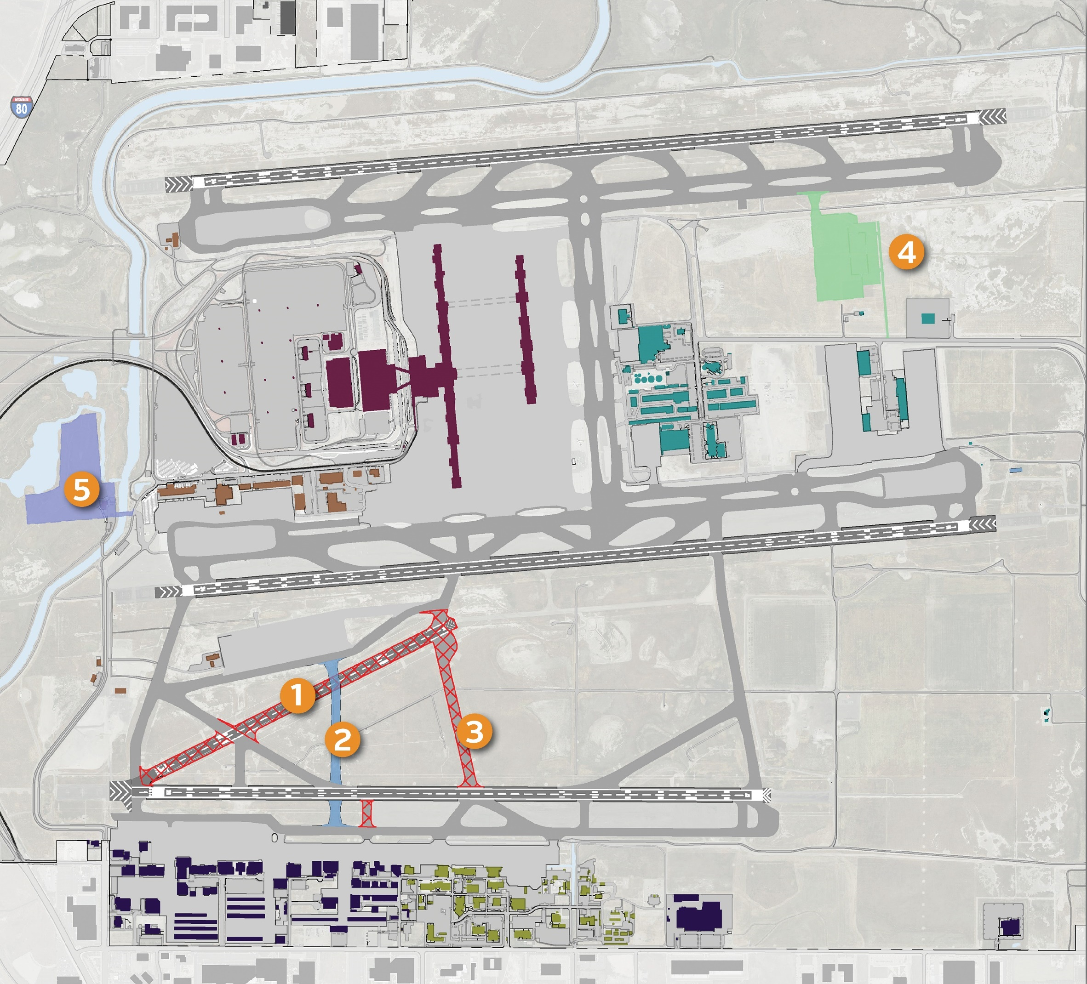
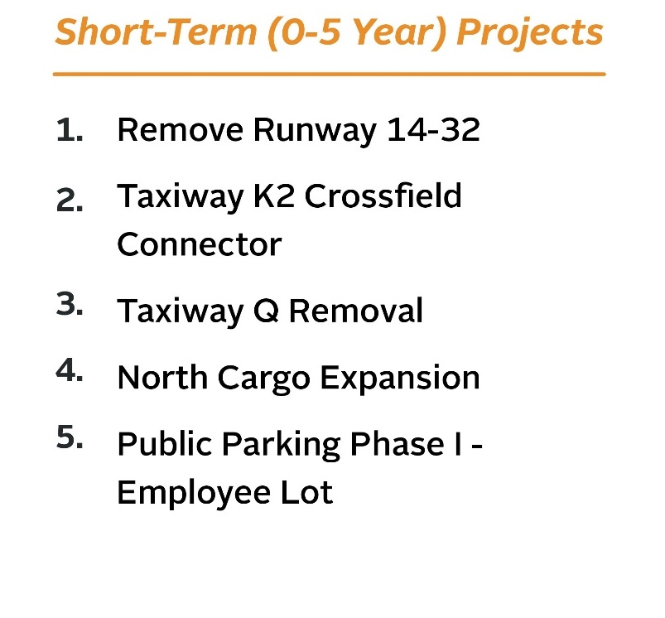
Short Term

Slide 30
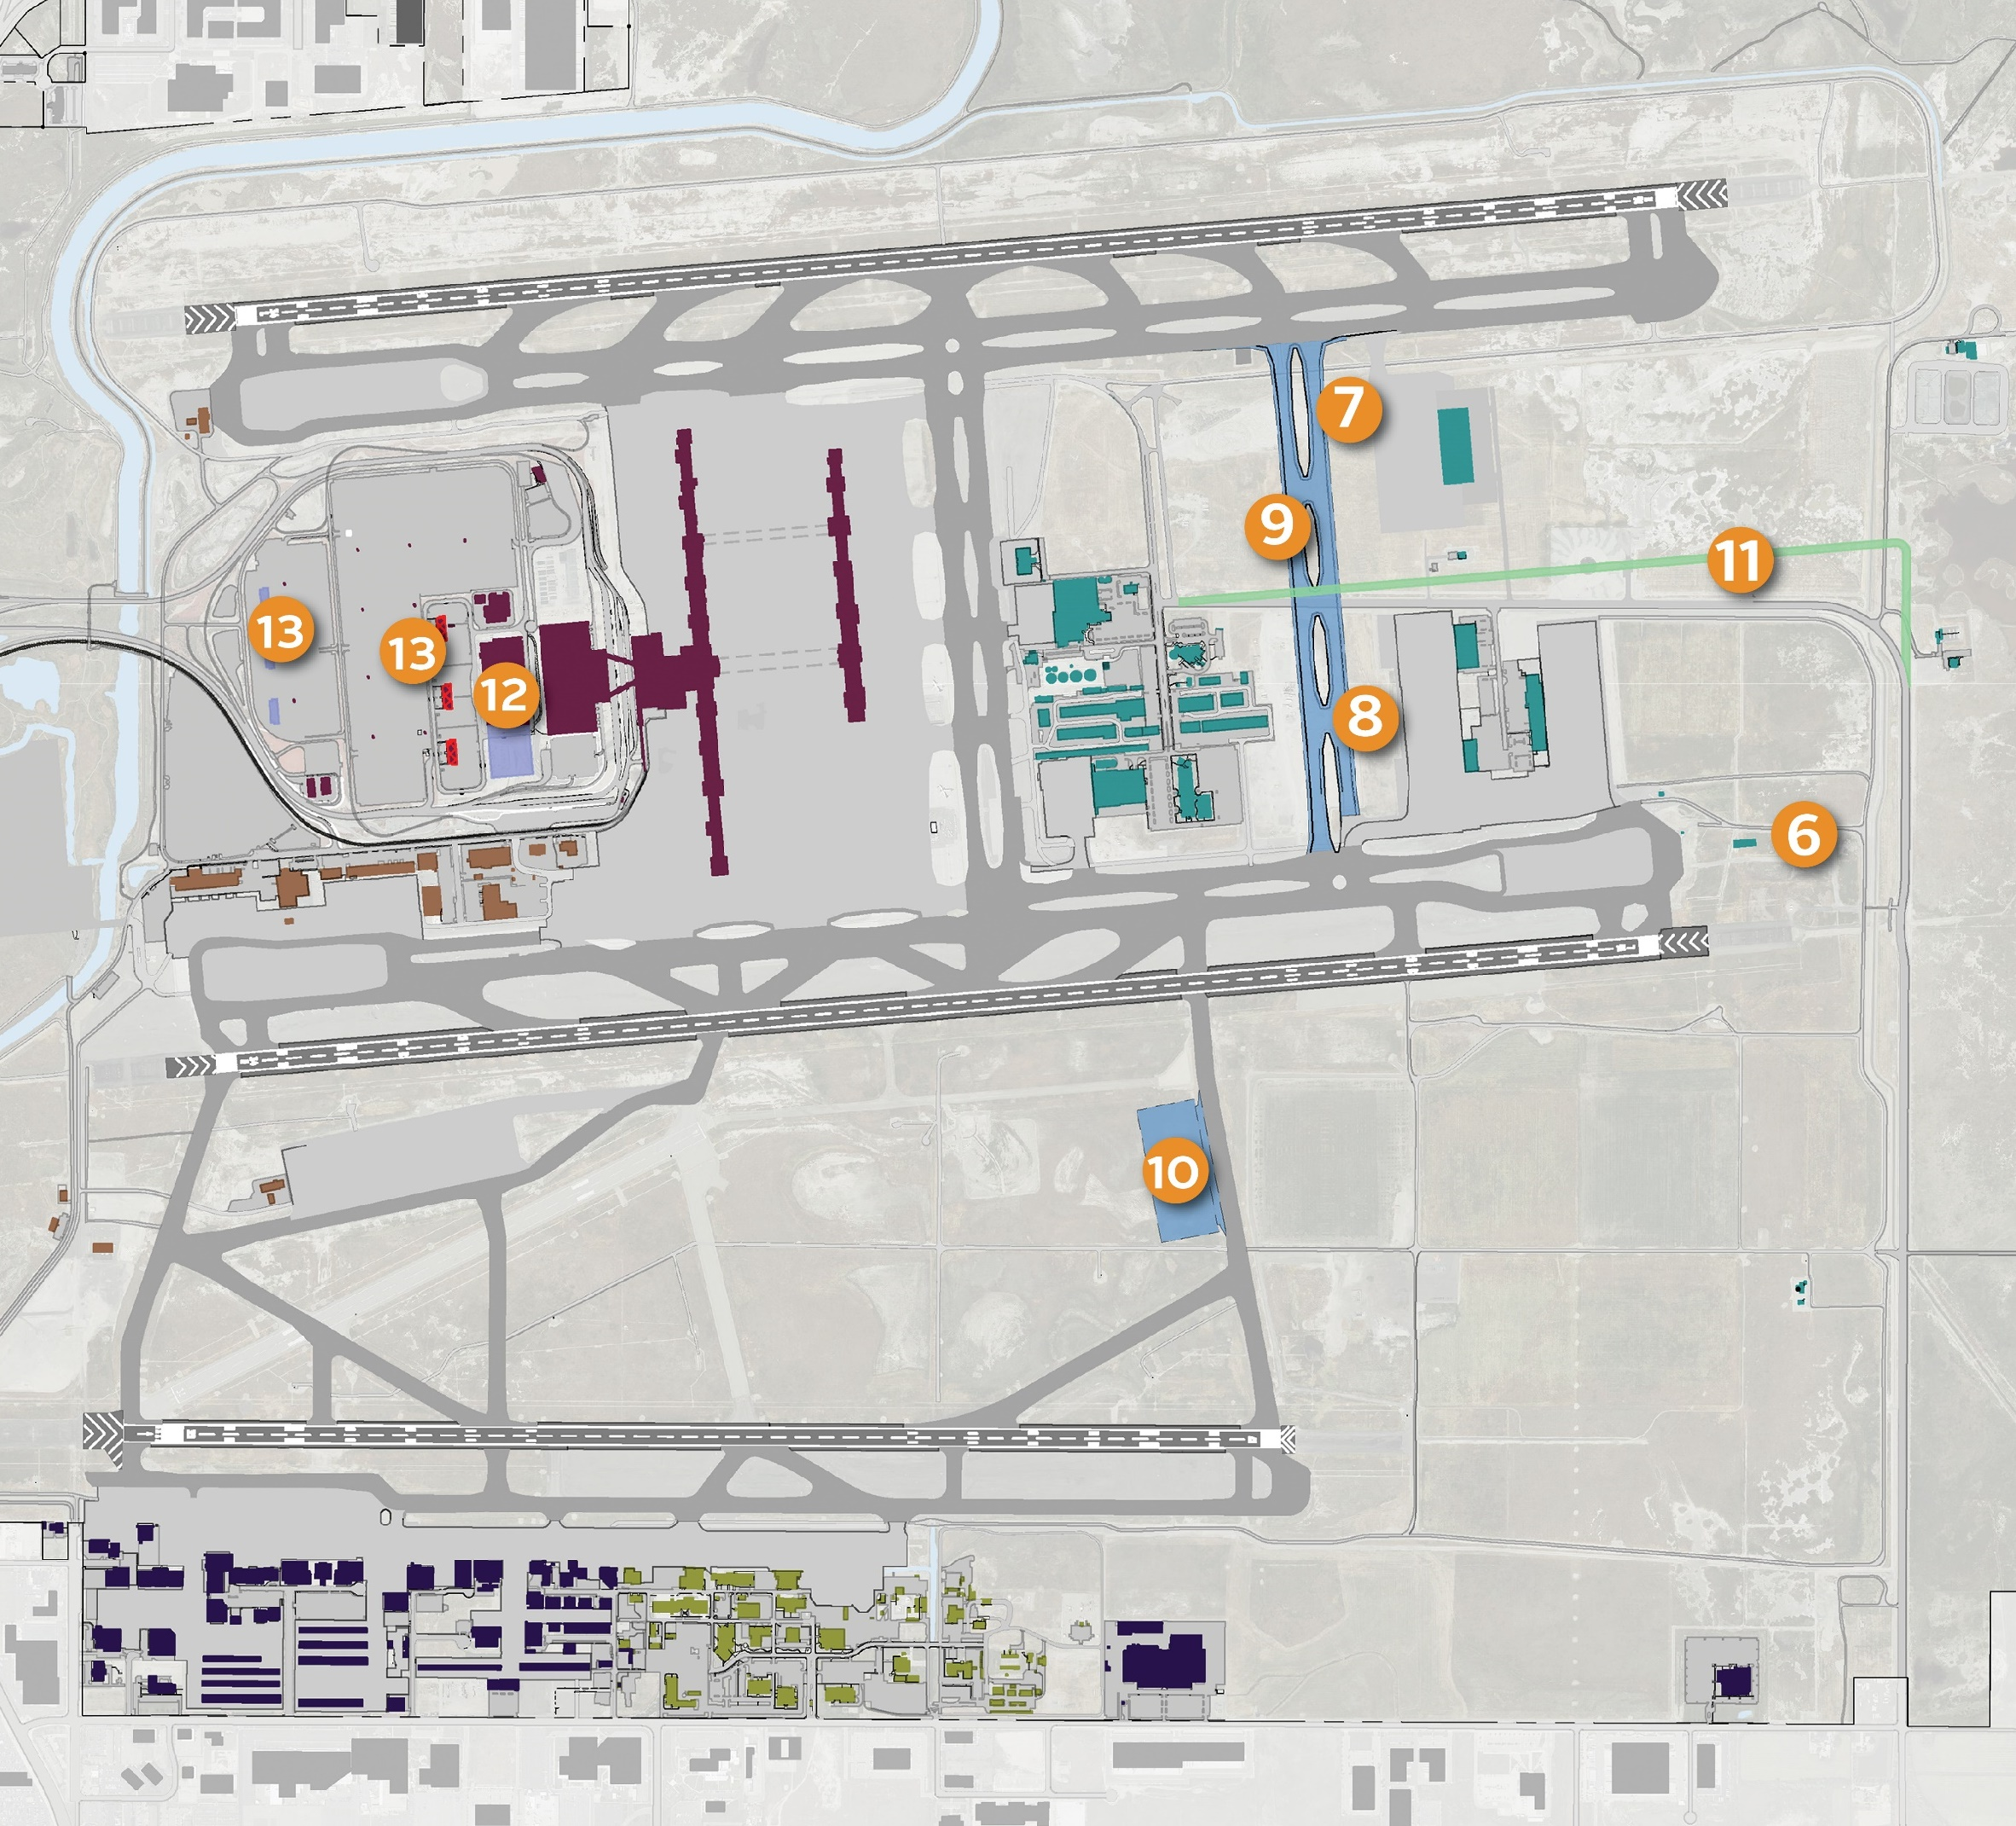
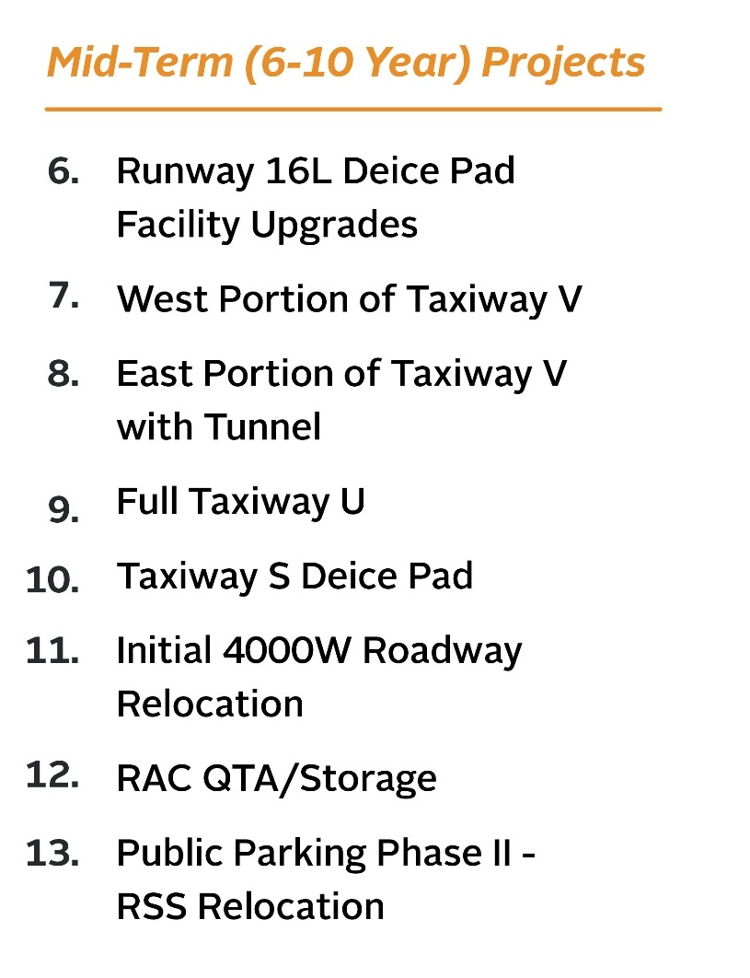
Mid Term

Slide 31
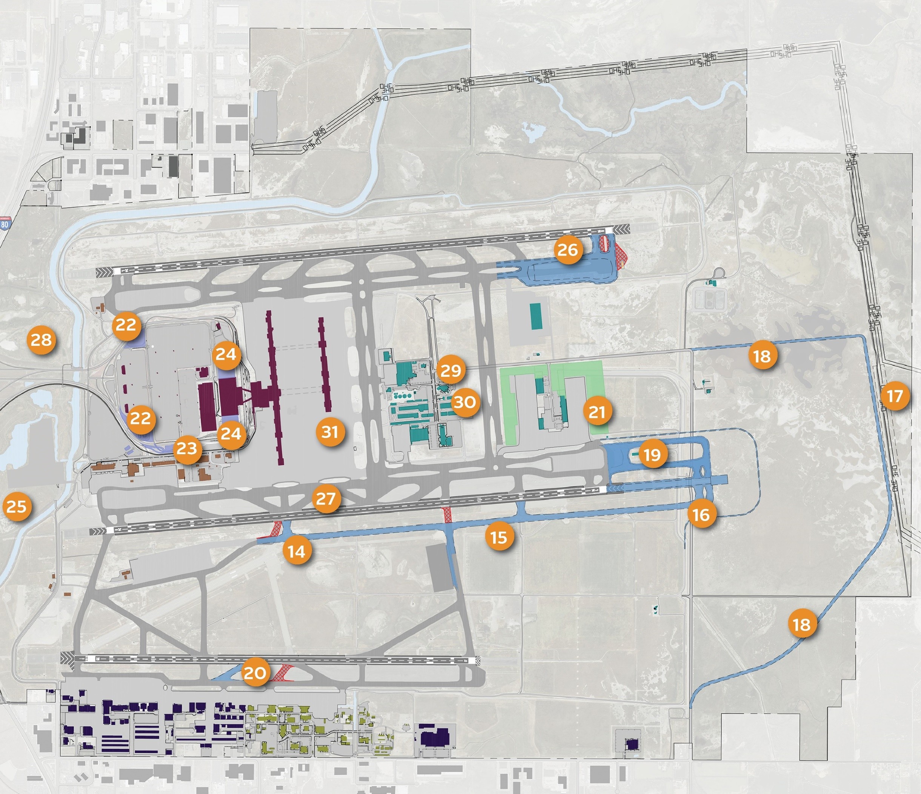
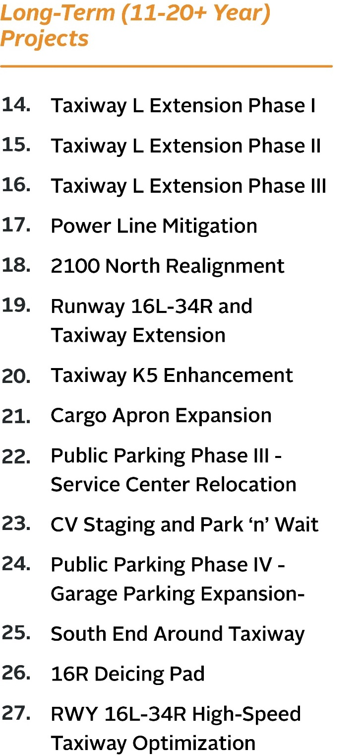
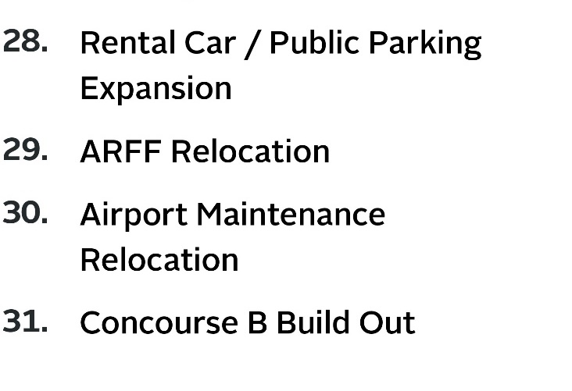
Long Term
Taxiway L Extension
Phase I
Taxiway L Extension
Phase II
Taxiway L Extension
Phase III
Power Line Mitigation
2100 North Realignment
Runway 16L-34R and
Taxiway Extension
Taxiway K5 Enhancement
Cargo Apron Expansion
Public Parking Phase III –
Service Center Relocation
CV Staging and
Park ‘n’ Wait
Public Parking Phase IV –
Garage Parking Expansion
South End Around Taxiway
16R Deicing Pad
RWY 16L-34R High-Speed
Taxiway Optimization
Rental Car / Public
Parking Expansion
ARFF Relocation
Airport Maintenance
Relocation
Concourse B Build Out
Notes:
Remove 28 and update numbering

Slide 32
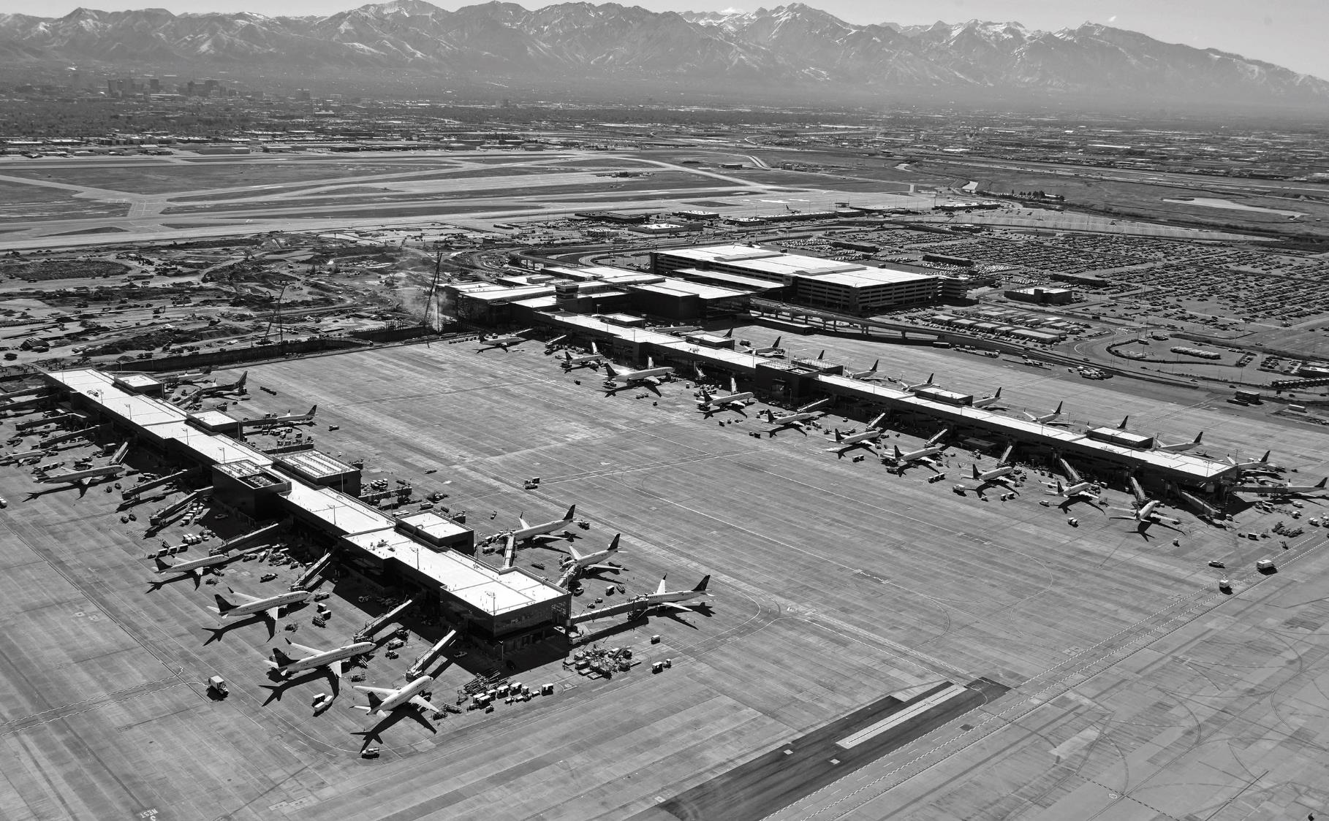
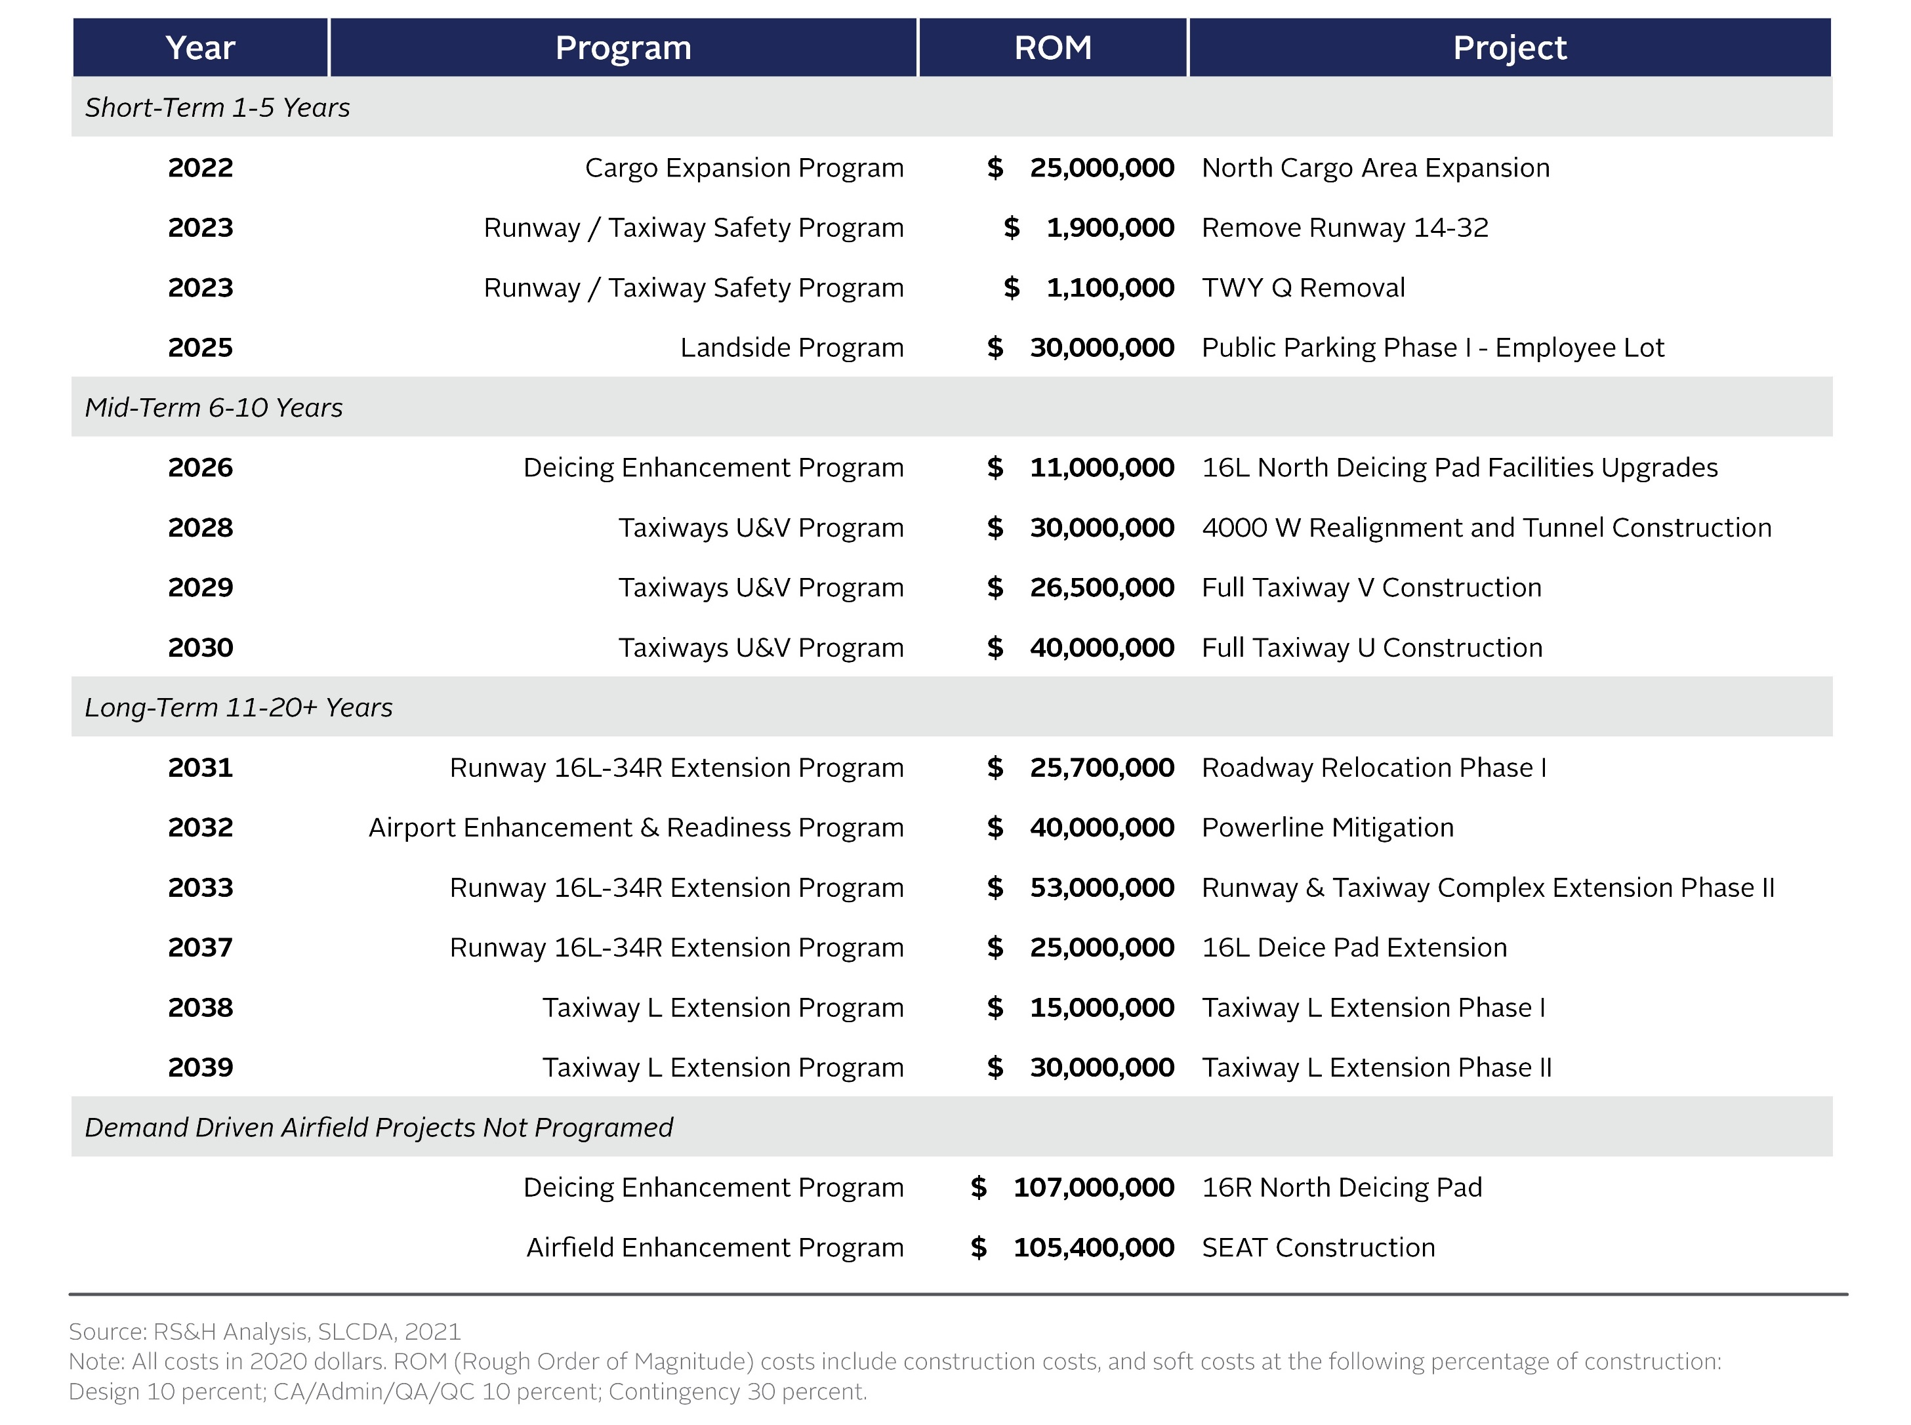
Development Costs

Slide 33











Thank you
Airspace System Planning
Airport
GIS
Aviation Noise Consulting (DBE)
Land
Development
Tower Siting/Airspace
Airspace
Assessment
Simulation Modeling
(DBE)
Public Involvement
Program
Airport Landside
System
Forecasting
(DBE)
Utility/Infrastructure Coordination

